Slide 1
One platform, many partners
The British Library‘s shared research repository as service for cultural and research organisations
Dr Torsten Reimer Head of Content and Research Services
Torsten.Reimer@bl.uk / @torstenreimer http://orcid.org/0000-0001-8357-9422
Von Open Science zu Citizen Science: Openness und Kunst- und Museumsbibliotheken, Online, 10th December2021

Slide 2
The BL (open access) repository service
The British Library offers a repository service in the following flavours:
Individual repositories with own branding
Several repositories connected through a shared discovery layer
A single repository used collaboratively by several organisations
We are offering this as a trusted public sector organisation whose existence is guaranteed by UK law. The service is built on open source software and deployed in a partnership model at sustainability and not at financial profit.
Furthermore, we are not just offering a barebones repository but we use the platform ourselves, and we keep investing in it and enriching it with the experience of a world-leading research library.
Delivered with our technical partner CoSector (part of the University of London).
Currently, the service is tailored to cultural organisations like museums.

Slide 3
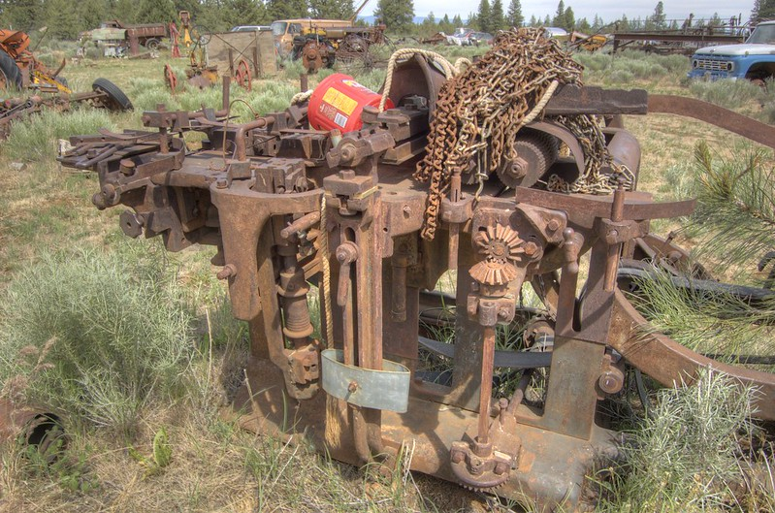
Where we started from
https://www.flickr.com/photos/darronb/14061239268/ CC BY 2.0
Notes:
When we set out on this journey, we had to support a range of repository and repository-like services, some built on a shoe-string budget, others quite old and in need of urgent upgrades. This is not an uncommon situation, as many organisations struggle to keep digital services current.

Slide 4
Plans for BL repository platform
Consolidate aging repositories on a single platform
Refresh the petabyte-scale preservation system for the national collection
Build an access layer that allows us to easily spin up multiple repositories
Preservation Layer
Data.bl.uk
EThOS
Services Layer
BL Institutional Repository
Other BL Repositories
Access Layer

Slide 5
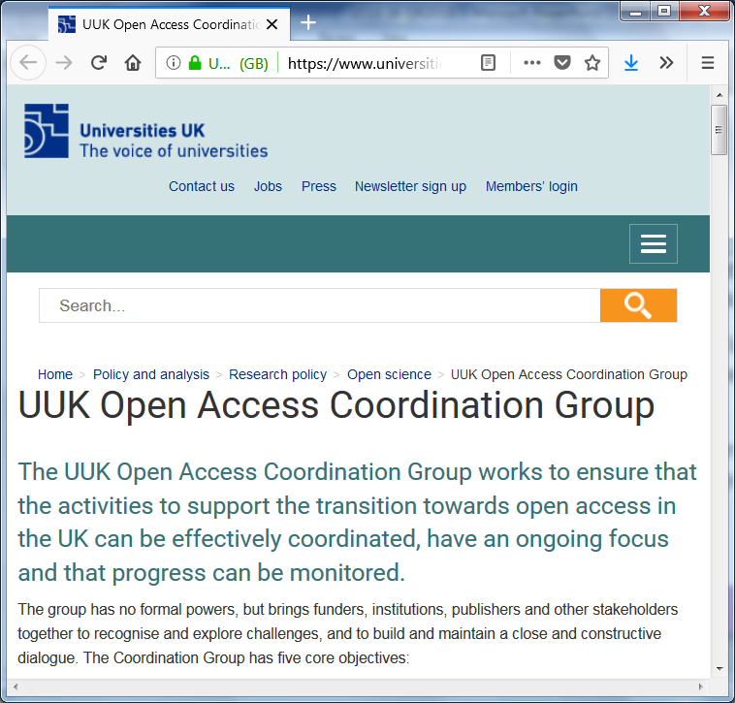
Repositories as national concern
A (2016) independent report on open access published by the Department for Business, Innovation & Skills asked us “to ensure that there is at least one permanent copy of an open access publication”.
The Universities UK Open Access Coordination Group, involving stakeholders such as government, funders, research organisations, publishers, libraries, set up a working group to look into the recommendations.
Meetings throughout 2017, a workshop at the British Library and a survey of repository managers across UK universities were conducted.

Slide 6
Challenges, (not just) for the UK
Concerns about sustainability of the underlying repository software package
Difficulties with CRIS system integration
Difficulties with integration with university systems (other than CRIS)
Difficulties with maintaining custom functionality
Issues with changing publisher and/or funder policies changing compliance status of articles
Lack of integration with identifiers (such as ORCID or DOIs)
Limitation of reuse through deposit licence (‘all rights reserved’), e.g. for text and data mining
Limited/no facilities (such as API) to support text and data mining
Linking publications to related datasets (and vice versa)
Linking publications to relevant funders
Management effort for journal embargoes
No or limited preservation functionality
Not enough resource to update from older/out-of date version of repository software
Not enough staff resource for operational management
Reporting facilities not sufficient for funder reporting
Reporting facilities not sufficient for internal reporting
Technical support: lack of skills / capability
Technical support: not enough capacity
Tracking/integrating AAMs deposited in subject/other institutional repositories (REF OA policy)
Usability and user interface issues
https://doi.org/10.5281/zenodo.1136075
Notes:
Some challenges for repositories, as identified by the working group. Our repository services wants to make a contribution to reducing these issues, by pooling resources and reduce the number of systems that need to be maintained.

Slide 7
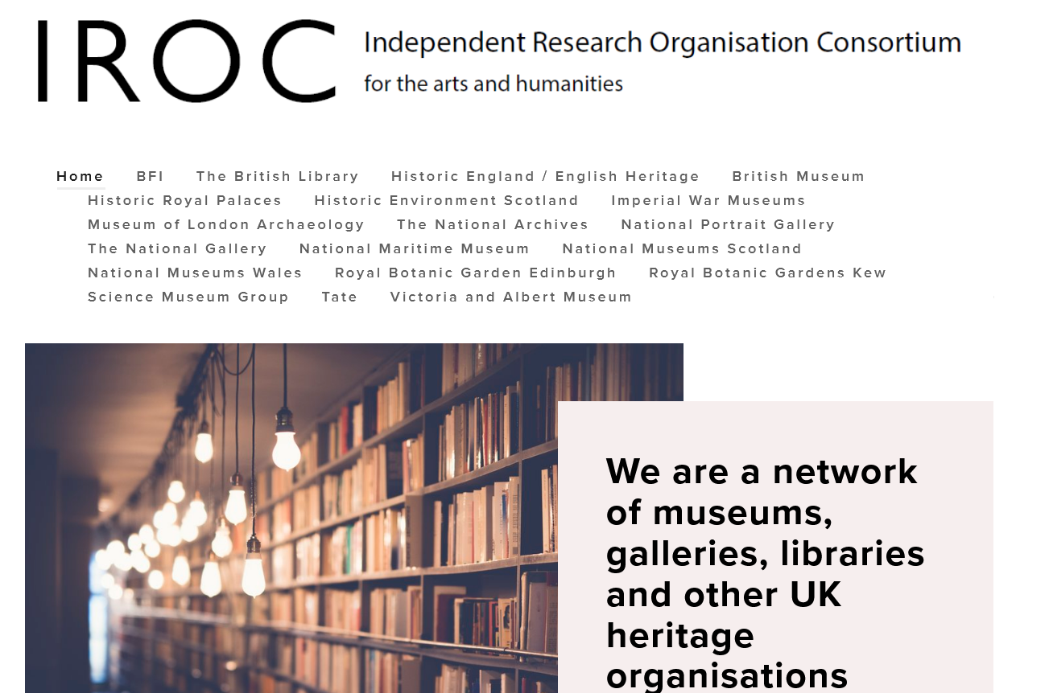
Notes:
Enter the IRO consortium – a network of BL partners who, around the same time, were discussing the need to implement their own repository services.

Slide 8
Expanded plans for the repository platform
Consolidate repositories on a single platform
Refresh the petabyte-scale preservation system for the national collection
Build an access layer that allows us to easily spin up multiple repositories
Host partner repositories on the same platform
Preservation Layer
BL Institutional Repository
EThOS
Services Layer
Other BL Repos
Access Layer
Partner Repo
Partner Repo
Notes:
We decided to offer our partners repository hosting on our emerging platform.

Slide 9
Built in Samvera Hyku
Open source, community built
Allows multiple tenant repositories hosted on a single repository instance
British Library actively contributing to future developments
Notes:
Open source, strong community.

Slide 10
Repository features
60+ ‘Resource type’ descriptors, including journal article, dataset, image, software, exhibition items, blog, guidelines, policy report, leaflets & newsletters
View image works (e.g. leaflets) on screen using Universal Viewer
Funder details captured via integration with Funder Registry
DOI look-up enables auto-population of new works
Integration with Datacite allows DOIs to be created on deposit
Also includes other identifiers such as ORCID, ROR and ISNI
A shared model can allow multiple organisations to deposit and manage combined content in a single repository

Slide 11
Shared Repository pilot
Notes:
Good range of partners:
MOLA have datasets in ADS. NMS already had Eprints repo, attracted by support for image content eg exhibitions, and potential benefits of being part of a bigger club. BM have lots of funded articles with 3rd party image content – focused on defining policies, rights and internal workflows. Tate focused on their web-hosted house journal which (they felt) was not being discovered through academic research channels – wanted to increase their research impact. Kew was added later to test the on-boarding of additional partners, currently focusing on Kew Science depts.

Slide 12
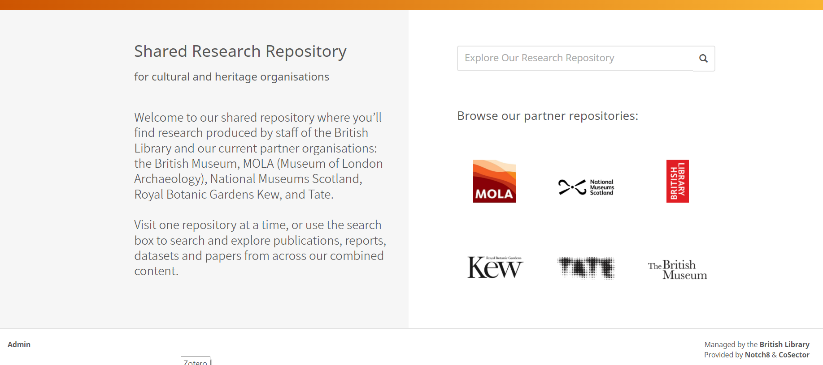
Shared research repository
https://iro.bl.uk
Notes:
So did many other cultural heritage organisations. We are all IROs.

Slide 13
Cultural heritage shared repository
Repository features:
Separate Hyku repositories on a single instance
A shared search layer to connect all content
Service features:
Partners have their own repository, own content, own workflows
Each partner has its own branding, logo – and unique URL
They have strong identities, users understand each org’s mission
Partners benefit from British Library repository and content expertise
Notes:
Cultural heritage – a repo each.

Slide 14
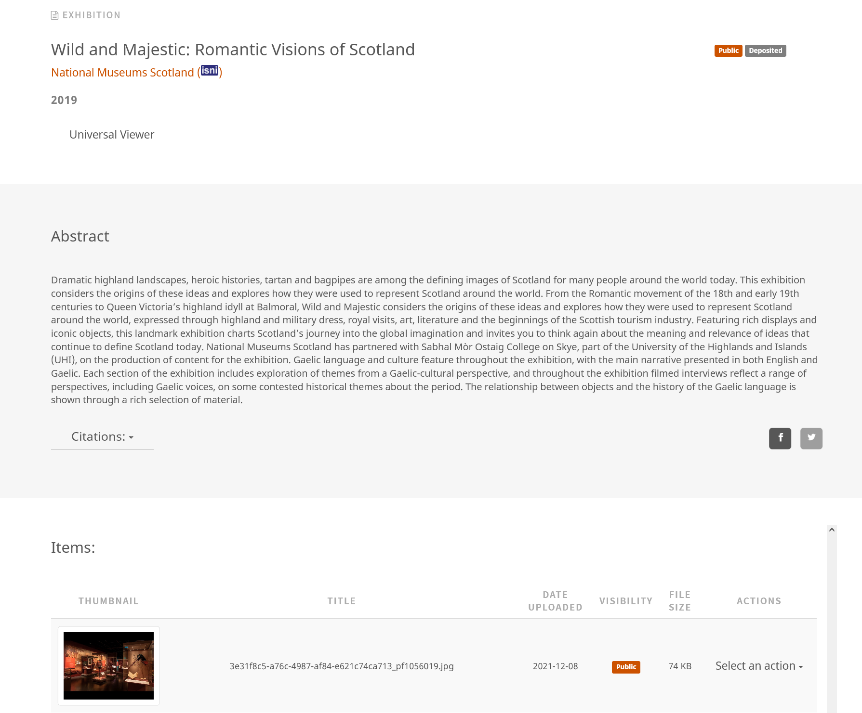
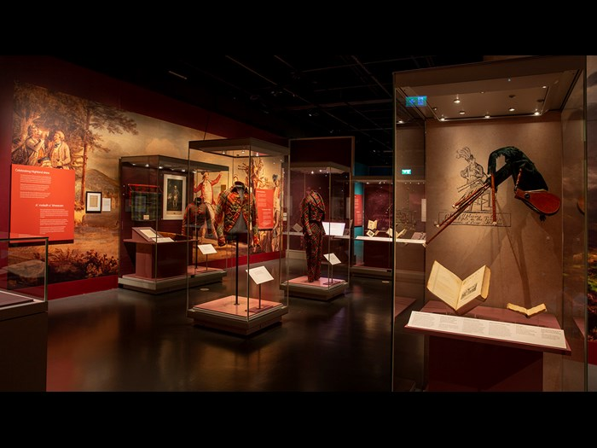
Example: exhibition content type
Notes:
Example of a repository page with image.

Slide 15
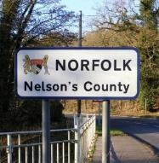
NHS pilot repository project
Jun 2021 – May 2022
Pilot partners:
Barts Health NHS Trust
Black Country Health Libraries Consortium
Birmingham and Solihull Mental Health NHS Foundation Trust
Gloucestershire Hospitals NHS Foundation Trust
Norfolk and Waveney Integrated Care System
Somerset NHS Foundation Trust

Slide 16
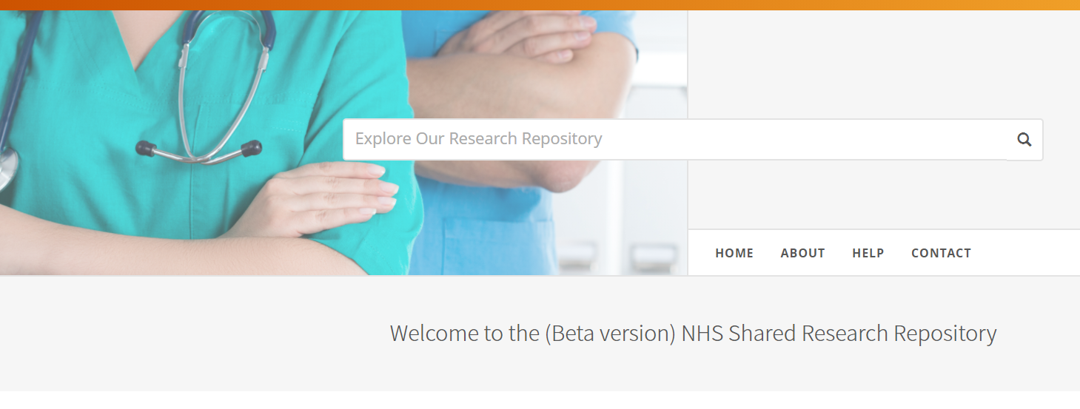
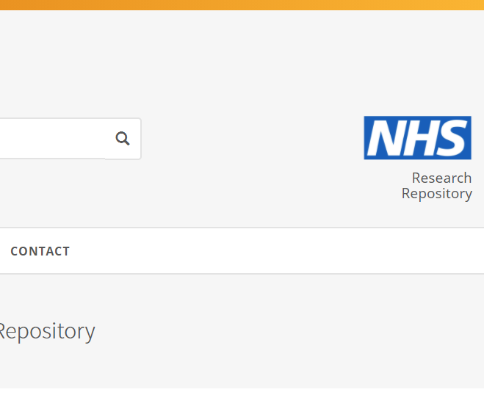
Shared NHS Open Access repository
https://nhs.iro.bl.uk

Slide 17
NHS pilot shared repository
Repository features:
A single repository shared by all six pilot NHS Trusts
Content is visible & editable by all admins
Not part of the cultural heritage shared search
Service features:
All depositing into a shared space – workflows and content policies are key
NHS is the strongest identity – a single shop window on ‘all’ publications
Governance is key
Pilot project will assess feasibility
Partners benefit from British Library repository and content expertise
Notes:
By contrast, our pilot project for the NHS has a single repos (following slides talk about NHS repo)

Slide 18
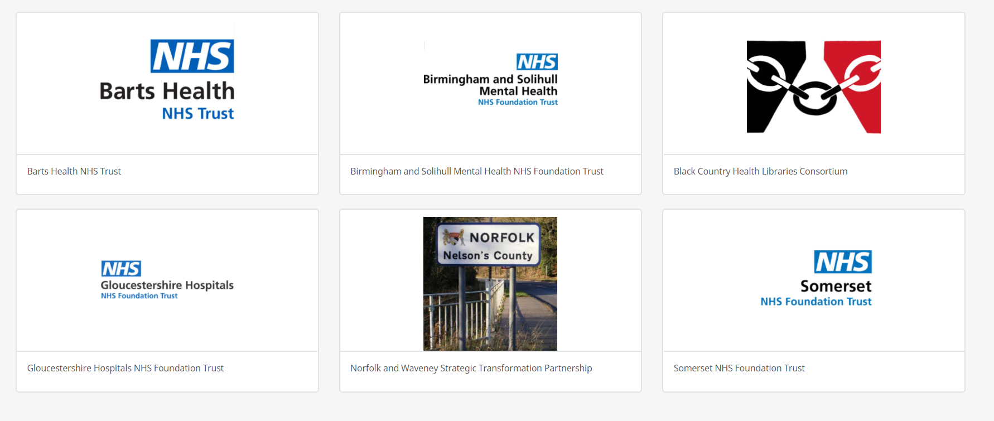
A repository ‘collection’ for each partner

Slide 19
Repositories are hosted & managed by the British Library
British Library repository services:
a single platform for multiple repositories
Cultural heritage shared repository
NHS shared repository
6 NHS organisations sharing one repository
British Library
National
Museums
Scotland
Museum
of London
Archaeology
Tate
galleries
Royal Botanic Gardens
Kew
British Museum
Notes:
Two possible options for repository set-up – separate repositories each, or a single shared one.

Slide 20
AHRC national infrastructure

Slide 21
Standard partnership model includes
A named BL account manager with 5 days per year of dedicated staff time
One client meeting and two community meetings per year
Option to contribute to the prioritisation of new feature requests
Defined Service Level Agreements with out of hours support
Monthly usage reports for both individual and shared repositories
2TB storage and 500GB/month bandwidth included
Optional repository-only DataCite service included at no charge
No exit charge, we will export the content if partners want to leave

Slide 22
Wider goals
Ensure there is ongoing investment in open source repository technologies
Create a community that can shape and influence the development of Hyku
Share best practice and work together to advance open access
Help cultural organisations and ideally those who aren’t well funded to make their content openly accessible

Slide 23
openaccess@bl.uk

